Slide 1


PI-21
Mojaloop
Community
Awards

Slide 2
Q4 2022
Builders
Contributor
Participants
Explorers
17
No Level
4
70
106
78
32
37
60
164
7
Notes:
This pulls orbit level for Q3 2022

Slide 3
Mojaloop Training Program
Quick update on Q3

Slide 4
User Data & Course Completion-Q4 2022
​ | End Q4​ | Totals​ | % ↑ in Q4​
Total Users​ | 60​ | 1,032​ | + 6%​
Total Countries​ | 5​ | 99​ | +5%​
​ | Enrolled​ | Completion​ | Total Enrollments-Q4​
Moja 101​ | 296​ | 204​ | 50​
Moja 102​ | 105​ | 48​ | 29​
Moja 103​ | 61​ | 36​ | 14​
Moja 104​ | 21​ | 12​ | 6​
DFSP 101​ | 552​ | 537​ | 12​
DFSP 209​ | 13​ | 4​ | 5​
Scheme 101​ | 34​ | 16​ | 10​
HUB 101​ | 32​ | 17​ | 7​
HUB 209​ | 19​ | 5​ | 3​
TTK​ | 31​ | 13​ | 12​
*Q2 is Partial to New Training Platform being Launched

Slide 5
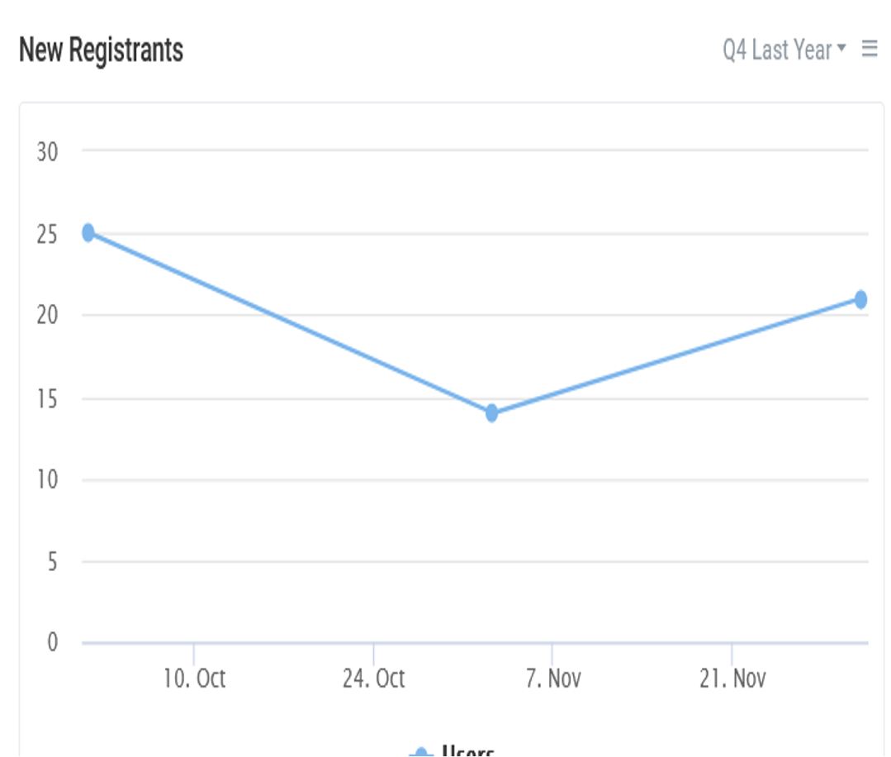
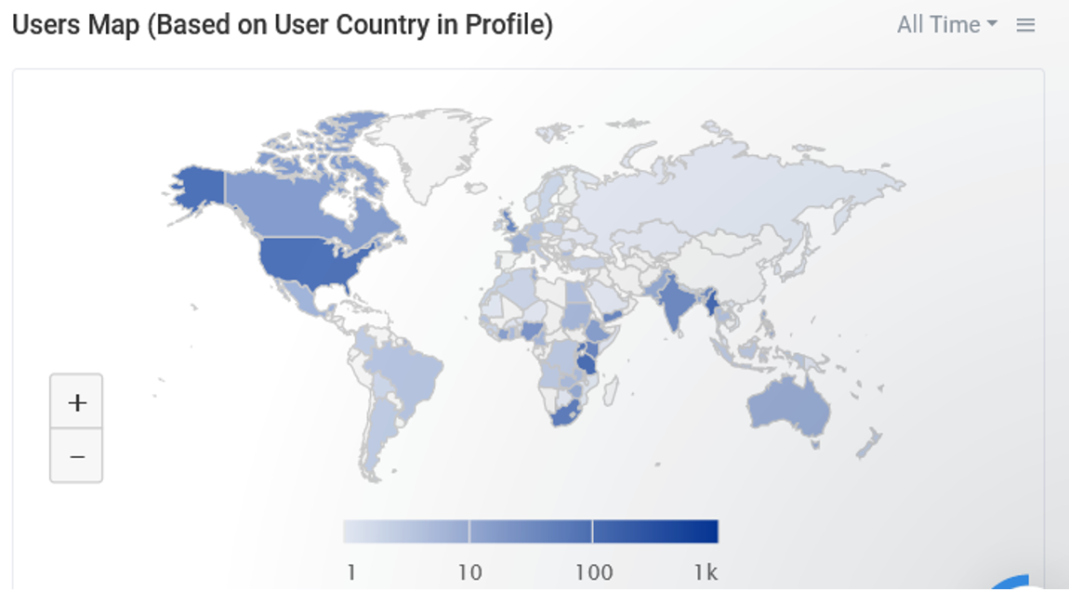
Course Activity – Q3 2022

Slide 6
Awards Time!
Active Community Members
New & Promising Members
Special Recognition

Slide 7
Active Community Members
Recognizing Community Members who have actively contributed to the development of Mojaloop

Slide 8
Active Community Members
Q4 2022
Miguel de Barros
Kevin Leyow
Sam Kummary
Vijay Guthi
Michael Wagener
Paul Baker
Michael Richards
Nicholas Ntulume
Sridevi Miriyala
Pedro Barreto
Notes:
Pulled from Leaderboard in quarterly stats run

Slide 9
New & Promising Community Members
Recognizing new and promising Community Members who have engaged actively in the Mojaloop ecosystem

Slide 10


New & Promising Community Members
Q4 2022
Nikhil Babu
Justin W. Flory
Spencer Biah
Michael Chavinda
Clifford Ganaseb
Pye Phyoe Aung
John Januszczak
Mudathir Salum
Thomastthai
Min Tha Gyaw
Notes:
Pulled from Q1 leaderboard in regular stats run

Slide 11
Special Recognition
Recognizing significant contributions by Mojaloop community members

Slide 12
Special Recognition
Elijah Okello
Eddy Kayiganwa

Slide 13
Notices & Reminders

Slide 14
Upcoming Events
PI-22 Community Meeting:
26th to 30th June 2023
Fully Virtual
PI-23 Community Meeting:
End October 2023
In-Person

Slide 15
Congratulations
to all our community members who received recognition during the PI-21 Community Meeting for their outstanding contribution to the Mojaloop Open Source Project

